Slide 1
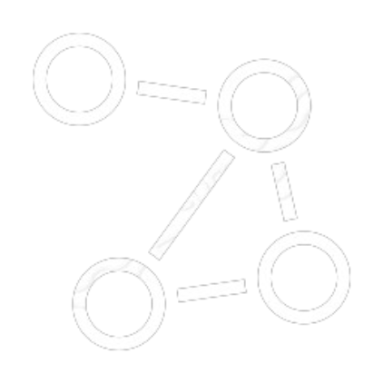

SDP Project 2024
Flow
Networks
Stefano Iacono 314601
Giulia Mascarin
Anjali Vaghjiani

Slide 2
Introduction

Slide 3

Maximum Flow Problem
Involves finding the maximum flow that can be sent from a source vertex to a sink vertex over flow networks.
Flow Networks are Weighted Directed Graphs, in which the vertices are nodes and the edges are the interconnections between two nodes, having their non-negative capacity.
The capacity is the constraint used to determine the maximum amount of flow sent through the network, while edge conservation is respected at each vertex.
Applications:
Network Routing
Traffic Flow Optimization
Resource Allocation in Supply Chain
Data Transmission in Computer Networks

Slide 4

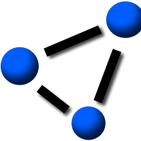



Benchmarks
Flow Networks Benchmarks were used to run tests over the algorithms. The datasets’ sources have been found online:
Network Data Repository
Stanford Biomedical Network Datasets Collection
Datasets | Tore Opsahl
Social Computing Data Repository at ASU
To run the programs:
laptops and virtualization
Google Colab

Slide 5
Technical Specifications of Testing Environments
Specification | Anjali | Giulia | Stefano
CPU | Intel(R) Core(™) i5-8265U CPU @ 1.60GHz 1.80 GHz | Intel(R) Core(™) i7 (6C, 2.6GHz) | Intel(R) Core(™) i5-4310M (2C/4T, 2.70-3.40 GHz)
RAM | 8.00 GB | 16,0 GB | 16,0 GB
OS | 64-bit operating system, x64-based processor | macOS Sonoma v. 14.5. | Ubuntu 20.04 Focal Fossa (64-bit) VM

Slide 6
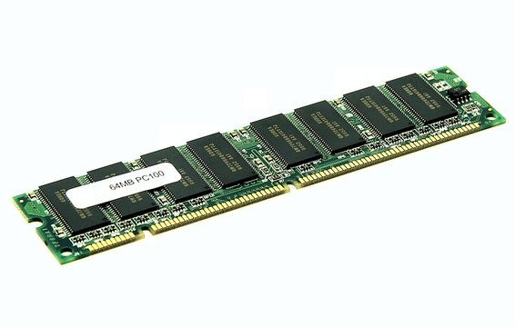
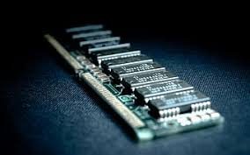

Technical Specifications of Testing Environments
Hardware | Laptops | Google Colab
 | 8 - 16 GB DDR4 | 13 GB
 | 2 - 4 CPUs (4 - 8 threads) | Intel Xeon CPU with 2 vCPUs

Slide 7
Algorithms

Slide 8
Edmond-Karp
The Edmond-Karp algorithm
implements the Ford-Fulkerson algorithm for maximum flow
uses the Breadth-First Search (BFS) to find the shortest path from the source to the sink to push the flow
O(VE²)
is simple but very slow
is not suggested for dense graphs

Slide 9
Dinic’s
The Dinic’s algorithm
optimizes the Ford-Fulkerson algorithm
performs the BFS to check if more flow is possible and to construct level graphs
each edge points to the next level
performs DFS on the level graphs to find blocking flows until there are no more
O(V²E)
better than EK, but more complex
not suggested for very large and dense graphs

Slide 10
Push-Relabel
The Push-Relabel algorithm
Push: excess flow from a node to a neighbor, if possible
Relabel: increase the height of a vertex to push more flow
Discharge: repeatedly push flow from a vertex until no
more possible, then relabel
strongly polynomial O(V²E)
very complex, but really efficient
naturally parallelizable

Slide 11
Design Choices and Parallelization
Adjacency Matrix instead of Adjacency List
More memory needed
More efficient
Compact files storing graphs including
# of nodes
edges and capacity
source and sink
OpenMP
Parallelization of the DFS and BFS for EK and Dinitz
Nodes findings and processing, protecting Push and Relabel phases (CS)

Slide 12
OpenMP API

Slide 13

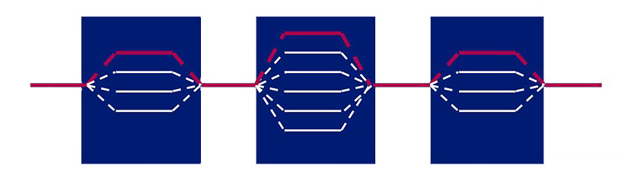
OpenMP
The OpenMP API uses the fork-join model with multiple threads performing tasks, defined with directives
An OpenMp thread is managed by the OpenMP implementation itself
All the OpenMP threads have a shared memory and a private one
omp.h library
-fopenmp option for compilation

Slide 14
Directives
Follows C/C++ standards for compiler directives
#pragma omp specifies a new OpenMP directive
Many types of directives
Fixed Source Form
Free Source Form
Stand-Alone
Meta

Slide 15
ICV
The Internal Control Values (ICV) control the behaviours of the OpenMP program
They store important information such as the number of threads to use for future parallel regions
They have an initial value, but they can be retrieved and modified using OpenMP API routines
omp_get_num_threads()
omp_set_num_threads()
omp_get_max_threads()
omp_get_thread_num()
omp_get_wtime()
others

Slide 16
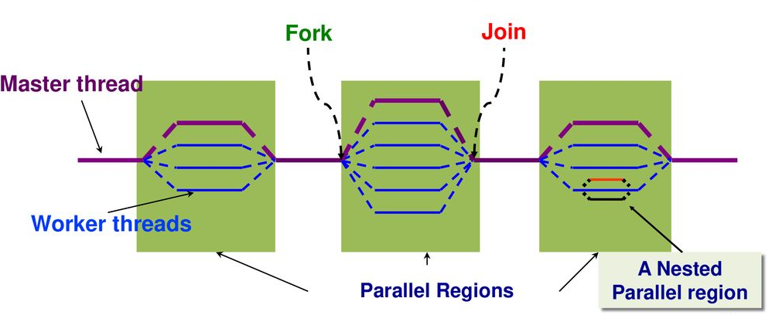
Parallel Construct
# pragma omp parallel [clause]
When a thread meets the parallel construct, a team of threads is created to execute the parallel region. The thread becomes the master thread of the new team
The team and the master thread execute the parallel region
Implicit barrier at the end of the parallel construct
Possibility to nest parallel regions
Clauses can enrich the parallel construct
num_trheads
shared

Slide 17
Other Constructs
Critical Construct only permits the region to be accessed once at time
Atomic Construct ensures that a specific storage location is accessed atomically
Flush Construct makes the thread memory consistent with shared memory

Slide 18
Algorithms in Comparison

Slide 19
Number of vertices 1000
Edge probability 1%
Maximum edge Capacity: 50
Algorithm used | Maximum Flow | Sequential Time Taken | No of threads for parallel | Parallel Time Taken
Dinitz | 225 | 0.04 | 2 | 0.0420001
Edmond-Karp | 225 | 0.511 | 2 | 0.52
Push-Relabel | 225 | 0.114 | 2 | 0.0969999
Number of vertices 5000
Edge probability 10%
Maximum edge Capacity: 20
Algorithm used | Maximum Flow | Sequential Time Taken | No of threads for parallel | Parallel Time Taken
Dinitz | 5028 | 0.67 | 2 | 0.692
Edmond-Karp | 5028 | 54.01 | 2 | 53.877
Push-Relabel | 5028 | 1.92 | 2 | 1.611

Slide 20
Number of vertices 100
Edge probability 30%
Maximum edge Capacity: 50
Algorithm used | Maximum Flow | Sequential Time Taken | No of threads for parallel | Parallel Time Taken
Dinitz | 590 | 0 | 2 | 0.000999928
Edmond-Karp | 590 | 0.0180001 | 2 | 0.00999999
Push-Relabel | 590 | 0.05 | 2 | 0.111
Number of vertices 100
Edge probability 100%
Maximum edge Capacity: 50
Algorithm used | Maximum Flow | Sequential Time Taken | No of threads for parallel | Parallel Time Taken
Dinitz | 2551 | 0.00100017 | 2 | 0.00399995
Edmond-Karp | 2551 | 0.0289998 | 2 | 0.029
Push-Relabel | 2551 | 0 | 2 | 0.00399995

Slide 21
Number of vertices 5000
Edge probability 50%
Maximum edge Capacity: 20
Algorithm used | Maximum Flow | Sequential Time Taken | No of threads for parallel | Parallel Time Taken
Dinitz | 26088 | 1.34751 | 4 | 1.2639
Edmond-Karp | 26088 | 1073.12 | 2 | 1072.03
Push-Relabel | 26088 |  | 4
Number of vertices 10000
Edge probability 5%
Maximum edge Capacity: 20
Algorithm used | Maximum Flow | Sequential Time Taken | No of threads for parallel | Parallel Time Taken
Dinitz | 5665 | 5.42971 | 4 | 3.80329
Edmond-Karp | 5665 | 876.196 | 4 | 877.335
Push-Relabel | 5665 | 10.0779 | 4 | 8.45053

Slide 22
Number of vertices 10000
Edge probability 1%
Maximum edge Capacity: 50
Algorithm used | Maximum Flow | Sequential Time Taken | No of threads for parallel | Parallel Time Taken
Dinitz | 2611 | 5.740 | 2 | 3.708
Edmond-Karp | 2611 | 570.535 | 2 | 574.839
Push-Relabel | 2611 | 8.989 | 2 | 0.025
Number of vertices 25000
Edge probability 1%
Maximum edge Capacity: 20
Algorithm used | Maximum Flow | Sequential Time Taken | No of threads for parallel | Parallel Time Taken
Dinitz | 2484 | 25.934 | - | -
Edmond-Karp | - | - | - | -
Push-Relabel | 2484 | 56.801 | 8 | 46.568

Slide 23
Number of vertices 10000
Edge probability 85%
Maximum edge Capacity: 20
Algorithm used | Maximum Flow | Sequential Time Taken | No of threads for parallel | Parallel Time Taken
Dinitz | 25215 | 3.728 | 3 | 3.546
Edmond-Karp | - | - | - | -
Push-Relabel | 25215 | 26.741 | 4 | 12.867
Number of vertices 20000
Edge probability 1%
Maximum edge Capacity: 20
Algorithm used | Maximum Flow | Sequential Time Taken | No of threads for parallel | Parallel Time Taken
Dinitz | 1992 | 21.1831 | 8 | 21.2485
Edmond-Karp | - | - | - | -
Push-Relabel | 1992 | 32.9769 | 2 | 32.8603

Slide 24
Conclusions

Slide 25
Conclusions
Hard to parallelize Edmond-Karp and Dinic’s, since they require synchronization between threads
BFS and DFS are inherently sequential
Parallelization not appreciable with few nodes in the graph
Limited CPU cores limits the speed up
Limited benchmarks’ resources
Relabel-Push best algorithm, Edmond-Karp worst, Dinic’s very fast

Slide 26
Thank You
Stefano Iacono 314601
Giulia Mascarin
Anjali Vaghjianii

